Slide 1
Design Patterns

Slide 2
GOF
The original book:
Design Patterns: Elements of Reusable Object Oriented Software
By:
Erich Gamma
Richard Helm
Ralph Johnson
John Vlissides
Four authors, hence, Gang of Four
23 “Classic” Software Design Patterns

Slide 3
Categories of Patterns
Creational Patterns
Deals with how to design the instantiation process of objects
Structural Patterns
Deals with how classes and objects are composed to form larger structures
Behavioral Patterns
Deals with algorithms and the assignment of responsibilities between objects

Slide 4
Creational Patterns
Encapsulate knowledge of which Concrete classes the system uses
Hide how instances of these classes are created and put together
Gives a lot of flexibility in what gets created, who creates it, how it gets created, and when it gets created
All the system at large knows is their INTERFACES…

Slide 5
Creational Patterns
Singleton
Factory
Abstract Factory
Builder
Prototype

Slide 6
Structural Patterns
Concerned with how classes and objects are composed to form larger structures
Use inheritance to compose interfaces or implementations
Describe ways to compose objects to realize new functionality
Flexibility of object composition comes from the ability to change the composition at run-time
Impossible with just compile time composition

Slide 7
Structural Patterns
Proxy
Adapter
Façade
Bridge
Composite
Flyweight
Decorator

Slide 8
Behavior Patterns
Concerned with algorithms and the assignment of responsibilities between objects
Describe not just patterns of objects or classes but also the patterns of communication between them
Characterize complex control flow that’s difficult to follow at run-time
Shift your focus away from flow of control to let you concentrate just on the way objects are interconnected

Slide 9
Behavior Patterns
Chain of Responsibility
Command
Interpreter
Iterator
Observer
Mediator
Memento
State
Strategy
Visitor
Template Method

Slide 10
Singleton Overview
One instance of class per process
Use static keyword
Used for
Shared resources
Memory cache
Keys for data
Translated strings
Use private constructor
Use Enum

Slide 11
Singleton
The Singleton Pattern allows you to:
Require only one object of a class
when you are a creating the context of an application
Or a thread manageable pool
Or registry settings
Or a driver to connect to the input or output console etc.
More than one object of that type clearly will cause inconsistency to your program
The Singleton Pattern ensures that a class has only one instance, and provides a global point of access to it

Slide 12
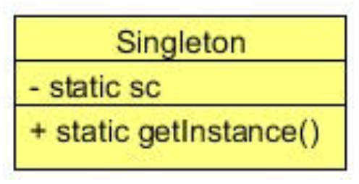
Class Diagram
private static class variable (here is sc)
public static getInstance() → returns the class variable
One instance of class per JVM (process)

Slide 13
When to use singleton
When there must be exactly one instance of a class
It must be accessible to clients from a well-known access point
When the sole instance should be extensible by sub-classing
Clients should be able to use an extended instance without modifying their code

Slide 14
Factory Overview
The Factory Pattern allows you to:
Encapsulate the instantiations of concrete types
It encapsulates the functionality required to select and instantiate an appropriate class
Uses a designated method referred to as a factory method
It selects an appropriate class from a class hierarchy based on the application context and other influencing factors
It instantiates the selected class and returns it as an instance of the parent class type.
Advantage → eliminates the need for an application object to deal with the varying class selection criteria and configuration

Slide 15
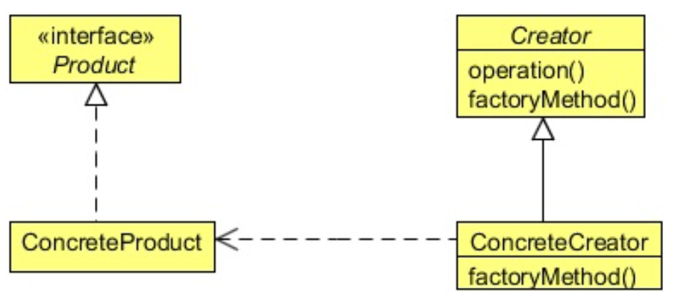
Class Diagram
Client get the Factory and calls the factoryMethod()
The factoryMethod() returns an instance of the Product
NOTE: it also configures the Product
The Client does NOT know how to configure the Product → hence decoupled

Slide 16
When to use
When:
A class can’t anticipate the class of objects it must create
A class wants its subclasses to specify the objects it creates
Classes delegate responsibility to one of several helper subclasses, and you want to localize the knowledge of which helper subclass is the delegate

Slide 17
Abstract Factory
The Abstract Factory Pattern allows you to:
Create families of related or dependent objects without specifying their concrete classes
Provides an interface to produce a family of objects
For each family, the Abstract Factory selects a Concrete Factory that manages the Object Creation for that family
Each concrete factory implements the interface of the abstract factory

Slide 18
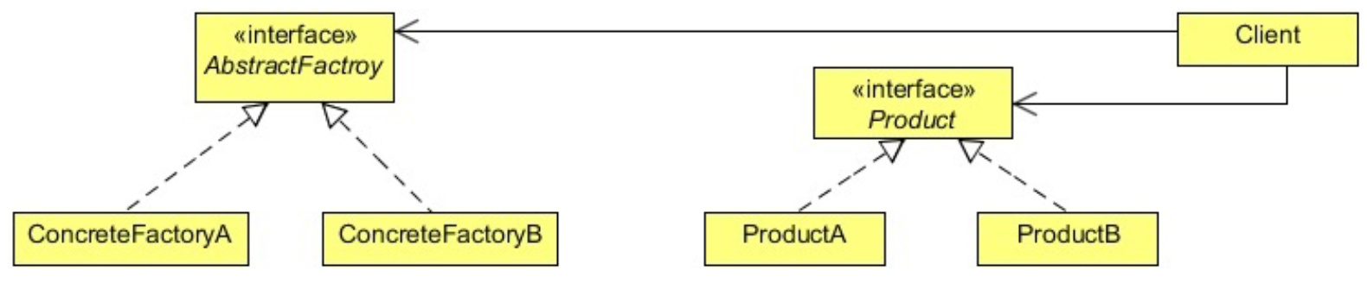
Abstract Factory
Client get the AbstractFactory (typically from a Factory)
Client uses the AbstractFactory to create Objects (Product) from a family of Products
Client uses the Product
The Client does NOT know how to configure the Product → hence decoupled

Slide 20
Abstract Factory

Slide 21
Builder
The Builder Pattern allows you to:
Encapsulate the instantiations of simple types
Add configuration properties, one at a time, instead of multiple properties in the Constructor
After entering all the properties, the Builder creates the simple object → often as an Immutable class.

Slide 22
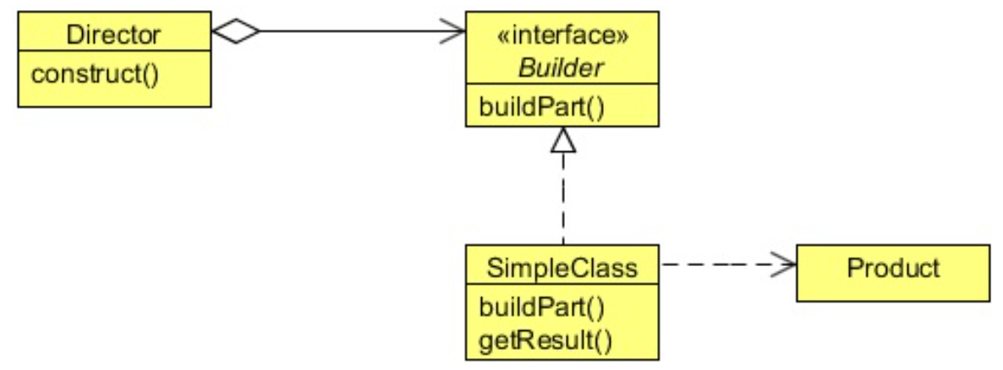
Builder
Client creates a new Builder from Director.Builder
Client uses modifiers on Builder to configure it
Client gets the Produce by invoking buildPart() on the Builder
Makes Use of Product much easier for Client

Slide 23
Builder When to use it
Use the Builder pattern when:
There are too many parameters to configure the Object
Telescoping of Constructors is too complex

Slide 24
Builder Pattern

Slide 25
Prototype
The Prototype Pattern allows you to:
Specify the kinds of objects to create using a prototypical instance
Create new objects by copying this prototype
Copy an existing object rather than creating a new instance from scratch
The newly copied object may change same properties only if required
This approach saves costly resources and time, especially when the object creation is a heavy process

Slide 26
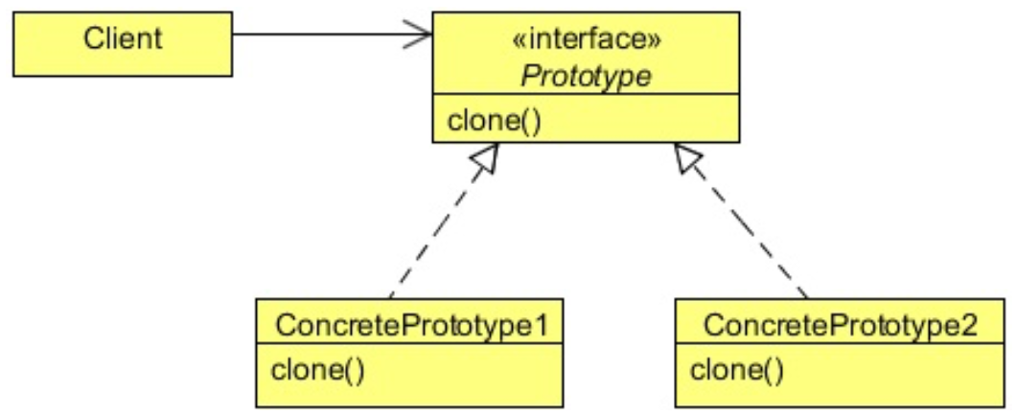
Prototype
Client creates a new Prototype from an existing Object
Uses clone() method which returns an Object
Must cast the return to be the object wanted

Slide 28
Façade Overview
Façade Pattern allows you to:
Make a complex interface easier to use
Provide a unified interface to a set of interfaces in a subsystem
Define a higher-level interface that makes the subsystems easier to use
Unify complex low-level interfaces of a subsystem in-order to provide a simple way to access that interface
It does not encapsulate the subsystem classes or interfaces
It just provides a simplified interface to their functionality
A client can access these classes directly
It still exposes the full functionality of the system for the clients who may need it
Decouple the client from a subsystem.

Slide 29
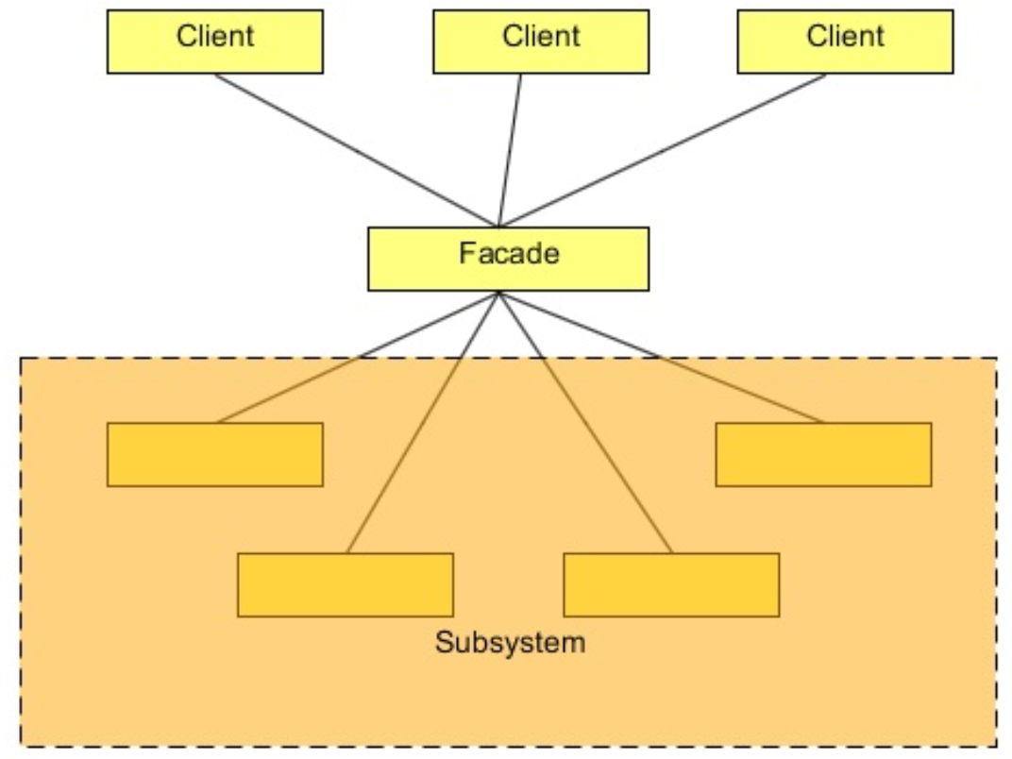
Class Diagram
The Façade provides a simpler interface to multiple sub systems
May be more than one Façade – depending on user, etc.

Slide 30
Decorator Overview
The Decorator Pattern allows you to:
Attach additional responsibilities to an object dynamically
Decorators provide a flexible alternative to sub-classing for extending functionality
Extend the functionality of an object dynamically without having to change the original class source or using inheritance
Create an object wrapper around the actual object

Slide 31
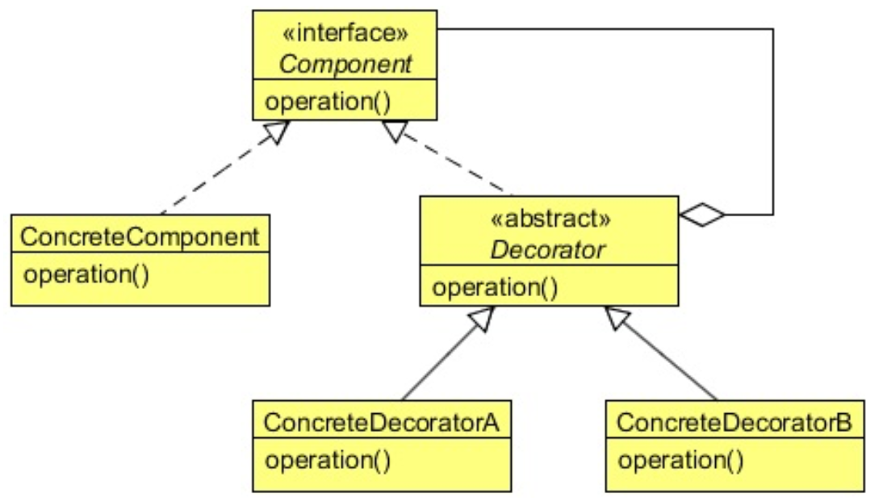
Class Diagram
Interface of Component and Decorator are IDENTICAL
Constructor of Decorator MUST have instance of Component

Slide 32
Decorator

Slide 33
When to use
When you want to change the responsibilities of an object without modifying the object
When you want to remove responsibilities
For Example: to create an Immutable Object
When extending a class is impractical (or illegal)
Java final class (e.g. Math)

Slide 34
Proxy
The Proxy Pattern allows you to:
Create a representative object that controls access to another object
Defer the full cost of its creation and initialization until we actually need to use it
Act as a local representative for an object that lives in a different JVM.
A client does not directly talk to the original object, it delegates it calls to the proxy object which calls the methods of the original object
Client does not know about the proxy, the proxy acts as an original object for the client

Slide 35
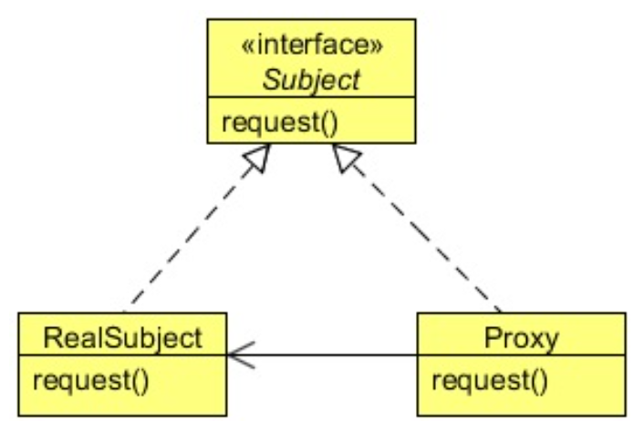
Proxy

Slide 36
Proxy

Slide 37
Proxy
The client get a Proxy (usually from a Factory)
The client calls a method on the Proxy
The Proxy intercepts the call
Like AOP, might do stuff here
The Proxy calls the Original Subject
Like AOP, might do stuff here
The Proxy returns data to the client

Slide 38
Flyweight
Flyweight is a structural design pattern that lets you fit more objects into the available amount of RAM by sharing common parts of state between multiple objects instead of keeping all of the data in each object
Also know as Cache
Use the Flyweight pattern only when your program must support a huge number of objects which barely fit into available RAM.

Slide 39
Composite
Composite Pattern allows you to:
Compose objects into tree structures to represent part- whole hierarchies
Allows clients to treat individual objects and compositions of objects uniformly
Think DOM – Document Object Model
Think File system – Folders and Files

Slide 40
Composite
Everything is a File
Has Name
Has permissions
Has Time Stamps (cts, mtd, etc…)
The Folder is the Composite
Might have children
Might have parent
Might have siblings

Slide 41
Composite

Slide 42
Bridge
Bridge is a structural design pattern that lets you split a large class or a set of closely related classes into two separate hierarchies—abstraction and implementation—which can be developed independently of each other.
Decouple two (or more) behaviors from the Client
Decouple an abstraction from its implementation
So that both can vary independently
Puts the abstraction and implementation into two different class hierarchies
So that both can be extend independently.

Slide 43
Bridge

Slide 44
Bridge when to use
You want to avoid a permanent binding between an abstraction and its implementation. This might be the case, for example, when the implementation must be selected or switched at run-time.
Both the abstractions and their implementations should be extensible by sub-classing
Changes in the implementation of an abstraction should have no impact on clients

Slide 45
Adapter
Adapter is a structural design pattern that allows objects with incompatible interfaces to collaborate.
is a special object that converts the interface of one object so that another object can understand it
Converts the interface of a class into another interface the client wants.
Allows classes to work together that couldn’t otherwise
Incompatible interfaces
Fixes the interface between the objects and the classes without modifying the objects and the classes directly

Slide 46
Adapter

Slide 47
adapter
When you have an existing class that you want to use
It has an inconvenient API
You want to create a reusable class that uses other interfaces
There are several existing Interfaces to use, but
Impractical to subclass all of them
You only want to use a few of the public APIs from an existing class.

Slide 48
Behaviour Patterns
Chain of Responsibility
Command
Interpreter
Iterator
Observer
Mediator
Memento
State
Strategy
Visitor
Template Method

Slide 49
Chain of Responsibility
Chain of Responsibility is a behavioral design pattern that lets you pass requests along a chain of handlers
Upon receiving a request, each handler decides either to process the request or to pass it to the next handler in the chain.

Slide 50
Chain of responsibility

Slide 51
Chain of Responsibility

Slide 52
Iterator
Iterator is a behavioral design pattern that lets you traverse elements of a collection without exposing its underlying representation (list, stack, tree, etc.).
The main idea of the Iterator pattern is to extract the traversal behavior of a collection into a separate object called an iterator.

Slide 53
Iterator

Slide 54
Iterator – When to use
Use the Iterator pattern when your collection has a complex data structure under the hood, but you want to hide its complexity from clients (either for convenience or security reasons).
Use the Iterator when you want your code to be able to traverse different data structures or when types of these structures are unknown beforehand.
You can use Iterators to traverse Composite trees

Slide 55
Template Method
The Template Method Pattern allows you to:
Define the skeleton of an algorithm in an operation, deferring some steps to subclasses
Let subclasses to redefine certain steps of an algorithm without changing the algorithm’s structure
Reuse the skeleton of an algorithm (the steps) when some steps might be implemented in multiple ways
Delegate multiple ways to subclasses
Only specific steps implemented in subclasses
Define default implementations in super class

Slide 56
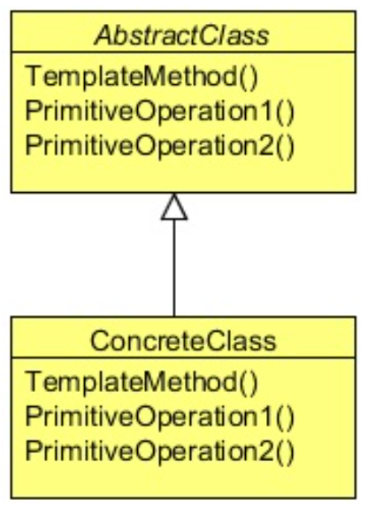
Class Diagram - Template
Client gets the ConcreteClass
Client calls templateMethod()
templateMethod() sequences the steps

Slide 57
When to use – Template Pattern
Use the Template Method pattern when you want to let clients extend only particular steps of an algorithm, but not the whole algorithm or its structure
Use the pattern when you have several classes that contain almost identical algorithms with some minor differences. As a result, you might need to modify all classes when the algorithm changes.

Slide 58
Visitor pattern
The Visitor Design Pattern:
Represents an operation to be performed on the elements of an object structure
Visitor lets you define a new operation without changing the classes of the elements on which it operates
Is useful when designing an operation across a heterogeneous collection of objects of a class hierarchy like a Composite
The Visitor pattern allows the operation to be defined without changing the class of any of the objects in the collection
Defines the operation in a separate class referred to as a visitor class
This separates the operation from the object collection that it operates on

Slide 59
Visitor

Slide 60
Visitor When to use
Use the Visitor Pattern when:
An object structure contains many classes of objects with differing interfaces → Think TREE structure
You want to perform operations on these objects that depend on their concrete classes → File vs Folder, Parent vs Child,
Visitor lets you keep related operations together by defining them in one class
When the object structure is shared by many applications, use Visitor to put operations in just those applications that need them
The object structure classes are stable. If they change often, you must change all the Visitors

Slide 61
Command
The Command Design Pattern:
Encapsulates a request as an object
Developer can parameterize clients with different requests
Queue or log requests
Support undoable operations
A Command object offers the functionality required to process the request
It does not contain the ACTUAL implementation of the functionality
The Receiver does the implementation

Slide 62
Command

Slide 63
Command when to use
Use the Command Pattern when you want to:
Parameterize objects by an action to perform.
Specify, queue, and execute requests at different times
A Command object can have a lifetime independent of the original request
Support undo
The Command’s execute() operation can store state for reversing its effects in the command itself
Support logging changes so that they can be reapplied in case of a system crash → e.g. A journaled file system.

Slide 64
Mediator
Mediator is a behavioral design pattern that lets you reduce chaotic dependencies between objects
The pattern restricts direct communications between the objects and forces them to collaborate only via a mediator object

Slide 65
Mediator

Slide 66
Mediator
Use the Mediator pattern when it’s hard to change some of the classes because they are tightly coupled to a bunch of other classes
Use the pattern when you can’t reuse a component in a different program because it’s too dependent on other components

Slide 67
Memento Pattern

Slide 68
Memento when to use
Use the Memento pattern when you want to produce snapshots of the object’s state to be able to restore a previous state of the object
Use the pattern when direct access to the object’s fields/getters/ setters violates its encapsulation

Slide 69
MeMento Pattern
Memento design pattern is used when we want to save the state of an object so that we can restore later on.
Memento pattern is used to implement this in such a way that the saved state data of the object is not accessible outside of the object, this protects the integrity of saved state data.

Slide 70
Observer Overview
The Observer Pattern:
Concerned with the assignment of responsibilities between objects
Shift your focus away from the flow of control to let you concentrate just on the way objects are interconnected
Defines a one-to-many dependency between objects so that when one object changes state, all its dependents are notified and updated automatically
The Observer pattern describes these dependencies
Is like Publisher-Subscriber relationship works

Slide 71
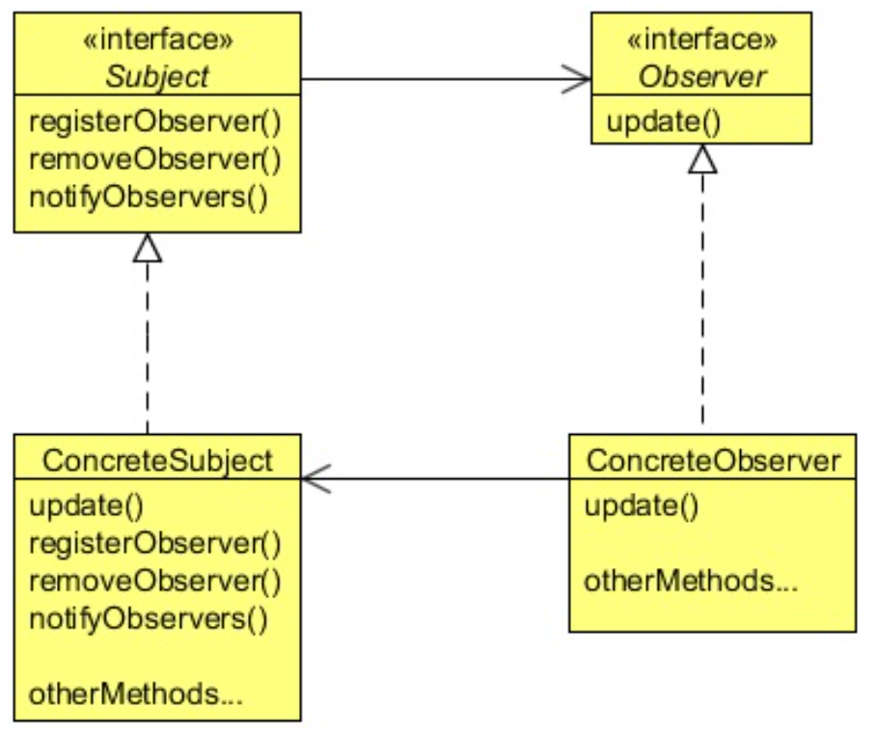
Class diagram
Observer registers with what to Observe (Observed or Observable)
Observed changes and update()s all Observers

Slide 72
Observer

Slide 73
When to use
Use the Observer pattern:
When an abstraction has two aspects, one dependent on the other
Encapsulating these aspects in separate objects lets you vary and reuse them independently
When a change to one object requires changing others, and you don’t know how many objects need to be changed
When an object should be able to notify other objects without making assumptions about who these objects are
In other words, you don’t want these objects tightly coupled

Slide 74
State Pattern
State is a behavioral design pattern that lets an object alter its behavior when its internal state changes. It appears as if the object changed its class.
The State pattern suggests that you create new classes for all possible states of an object and extract all state-specific behaviors into these classes.

Slide 75
State pattern Real world example
The buttons and switches in your smartphone behave differently depending on the current state of the device:
When the phone is unlocked, pressing buttons leads to executing various functions.
When the phone is locked, pressing any button leads to the unlock screen.
When the phone’s charge is low, pressing any button shows the charging screen.

Slide 76
Strategy Pattern
Defines a family of algorithms, encapsulating each one, and making them interchangeable
Strategy lets the algorithm vary independently from the clients that use it
Useful when there is a set of related algorithms and a client object needs to be able to dynamically pick and choose an algorithm from this set that suits its current need
Keeps the implementation of each algorithm in a separate class

Slide 77
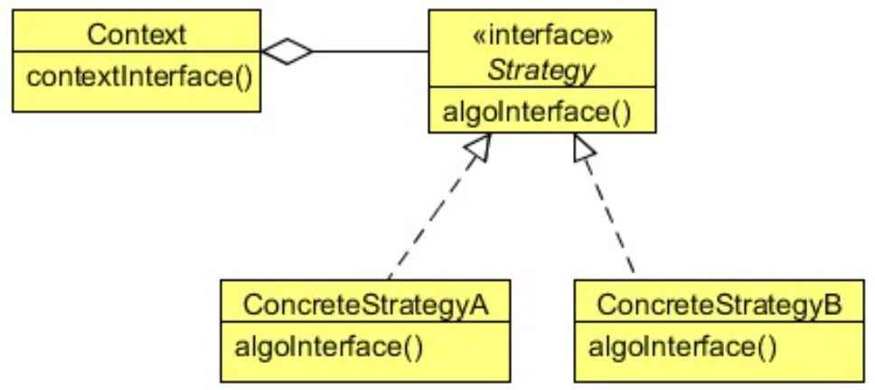
Strategy pattern
Strategy defines multiple algorithms
Same interface
Client determines which one to use based on its criteria

Slide 78
Strategy pattern real world example

Slide 79
Strategy pattern
Many related classes differ only in their behavior
Strategies provide a way to configure a class with one of many behaviors
You need different variants of an algorithm
When these variants are implemented as a class hierarchy of algorithms
An algorithm uses data that clients shouldn’t know about
Avoid exposing complex, algorithm- specific data structures.

Slide 80
Interpreter pattern
Interpreter pattern is used to defines a grammatical representation for a language and provides an interpreter to deal with this grammar.
The best example of interpreter design pattern is java compiler that interprets the java source code into byte code that is understandable by JVM.
Google Translator is also an example of interpreter pattern where the input can be in any language and we can get the output interpreted in another language.

Slide 81
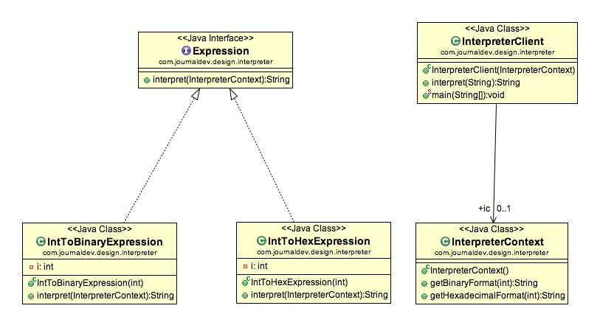
Interpreter pattern

Slide 82
Interpreter pattern
Interpreter pattern can be used when we can create a syntax tree for the grammar we have.
java.util.Pattern and subclasses of java.text.Format are some of the examples of interpreter pattern used in JDK.

Slide 83
Thank you

